Slide 1


Capstone Presentation TARP, LLC Jamie Anderson, Jon Harris, Vincent Ji, Joe Lu

Slide 2

About Us (TARP, LLC)
TARP, LLC is an investment advisory firm, powered by data science
Our goals:
Help investors understand opportunities in P2P lending
Invest their capital in more systematic manner, using data visualizations and machine learning models

Slide 3

Explosive Growth of P2P Lending
Rise of P2P lending fueled by increasingly powerful computers, plethora of big data sets, and banks lending less than pre-2008
For instance, now fin-techs provide 50% of unsecured personal loans in 2020 (compared to 20% in just 2015)

Slide 4

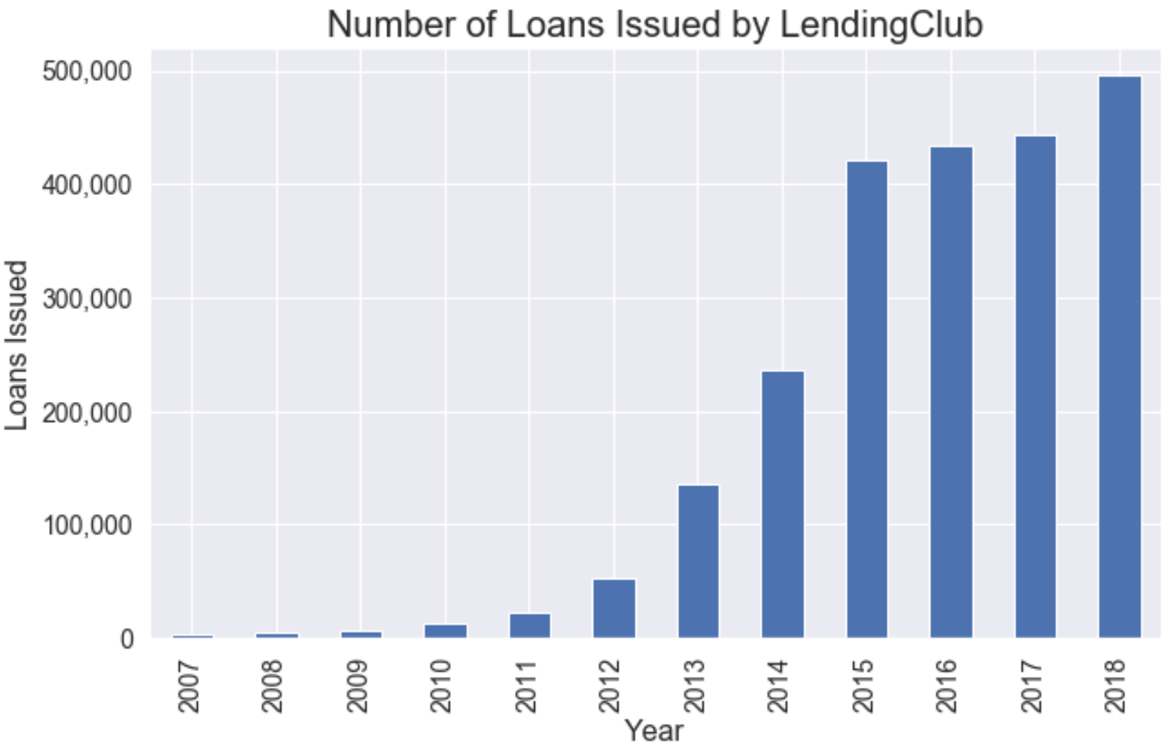
Explosive Growth of P2P Lending

Slide 5
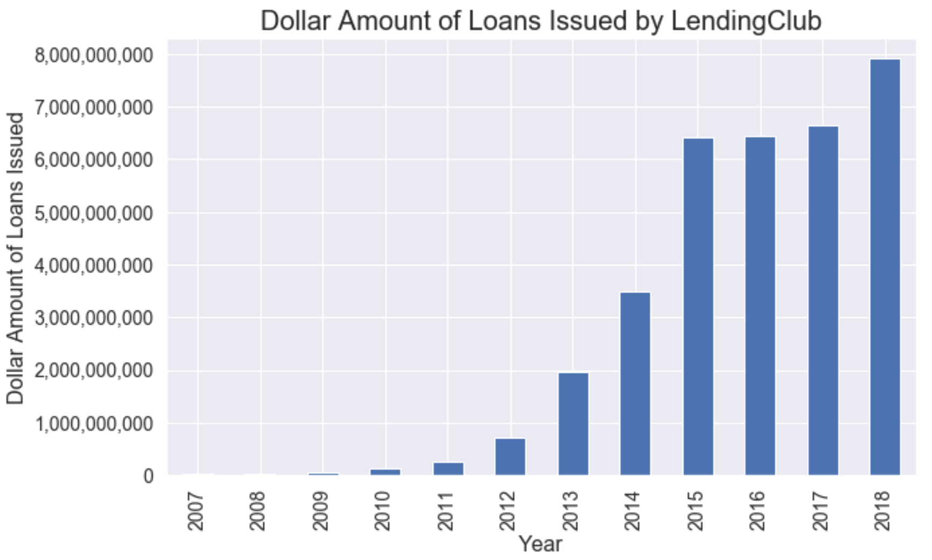
Explosive Growth of P2P Lending

Slide 6

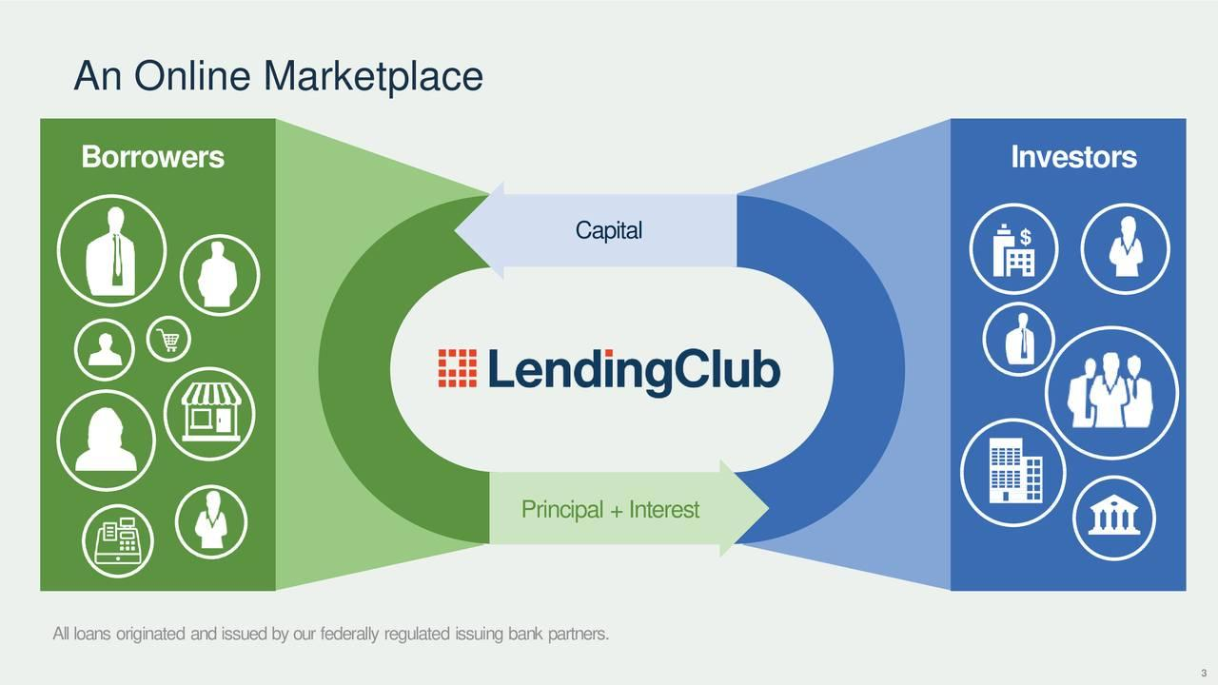
Benefits of P2P Lending

Slide 7
Benefits of P2P Lending
P2P matches borrowers and lenders online
Benefits to borrowers:
Borrowers can access funds quicker
Interest rates are often lower than those of banks and credit cards

Slide 8
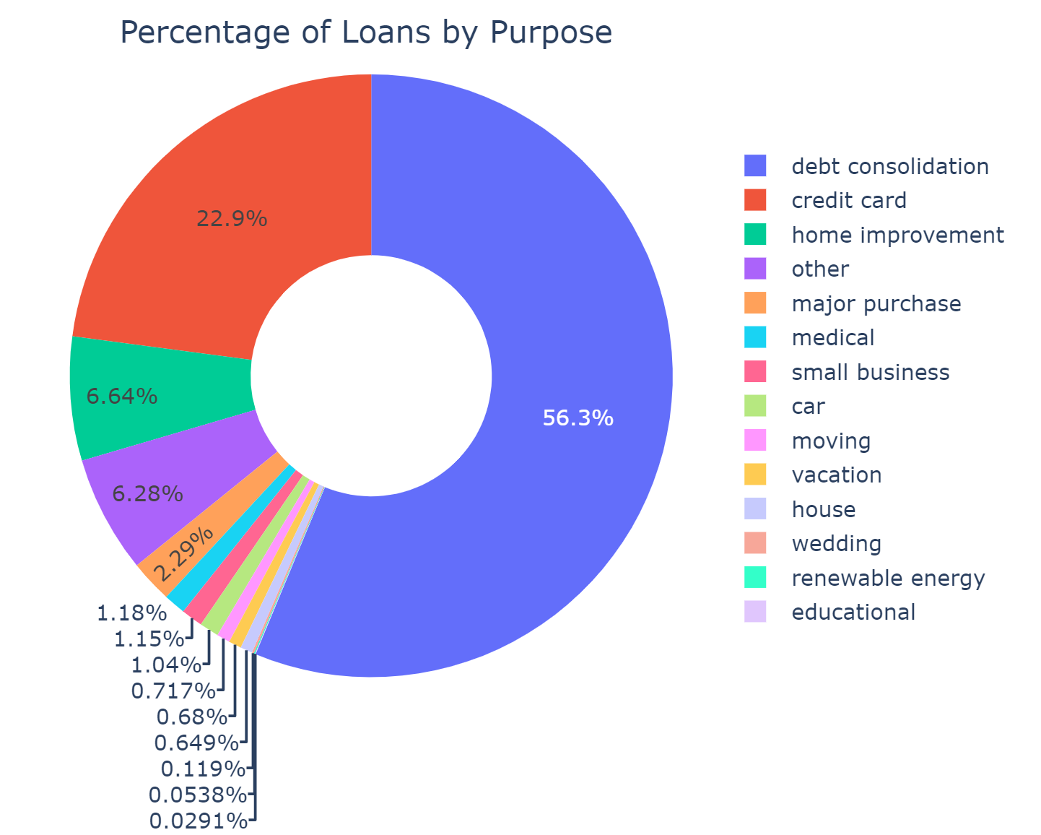
Benefits of P2P Lending

Slide 9
Benefits of P2P Lending
Benefits to investors:
Lend money (and receive returns) at a range of interest rates
Investors can invest in pools of loans: earn attractive (high) returns while spreading risk across multiple borrowers

Slide 10
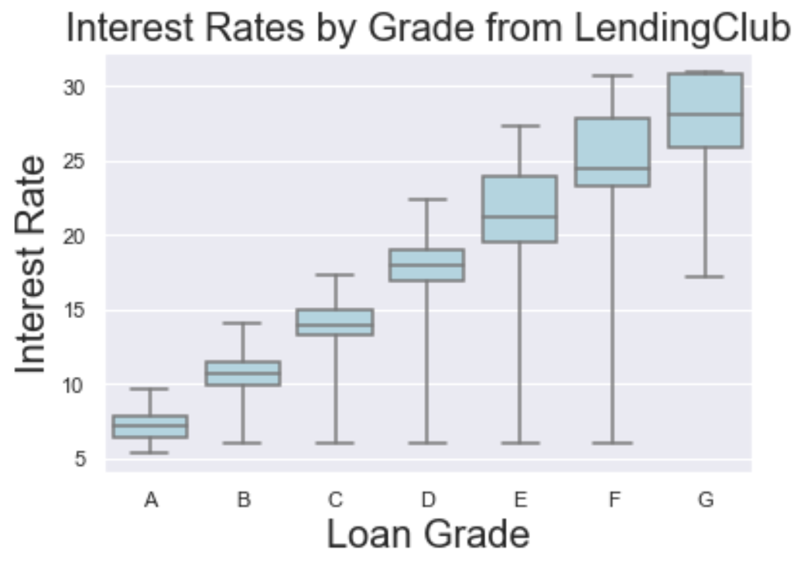
Benefits of P2P Lending

Slide 11

How does LendingClub Fit In?
In 2013, LendingClub received a $125 million investment from Google. Former Morgan Stanley CEO John Mack and former Treasury Secretary Larry Summers joined LendingClub’s board
In 2016, research paper by Fed Reserve concluded that LendingClub’s lending matched the efficiency of largest traditional lenders

Slide 12
How does LendingClub Fit In?
LendingClub determines if borrower is creditworthy based on credit score, payment history, requested loan size, debt-to-income ratio, and other factors
To reduce credit risk to investors, LendingClub approves only ~10% of loan applications and assigns interest rates proportionally to credit risk

Slide 13

Choosing a Loan as an Investor
Features to select from:
Interest rate of loan
Grade of loan
Term of loan
Borrower’s credit score
Borrower’s debt-to-income
Total 30+ factors to choose from

Slide 14
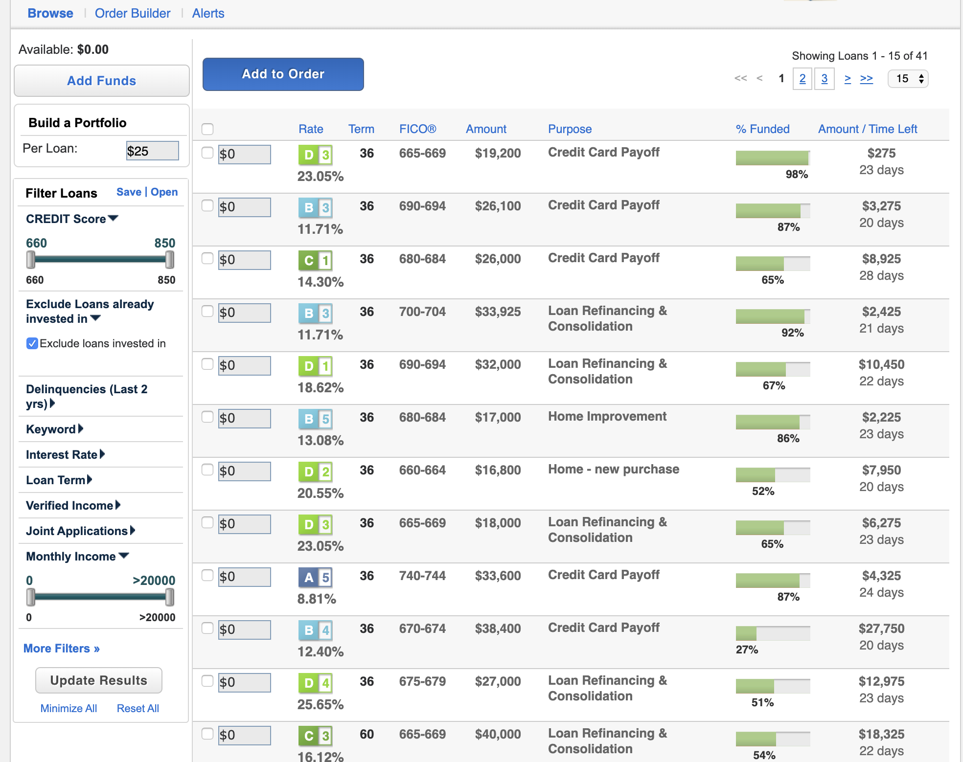

Choosing a Loan as an Investor

Slide 15
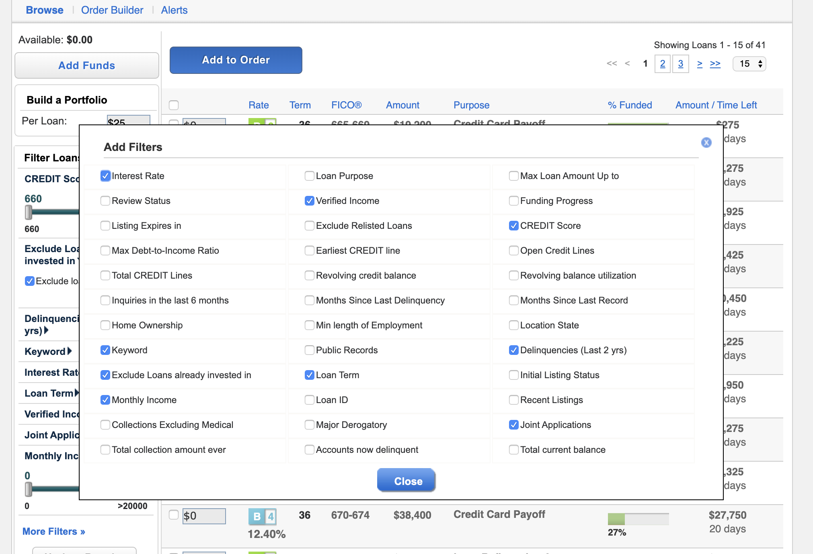

Choosing a Loan as an Investor

Slide 16
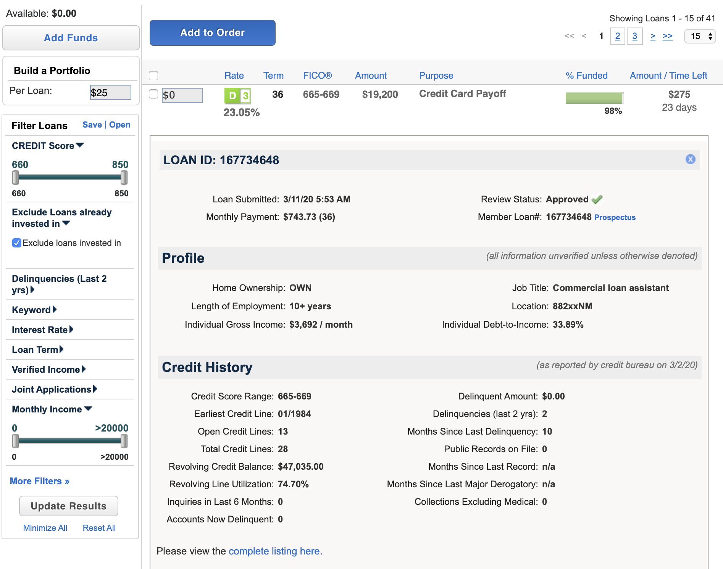
Choosing a Loan as an Investor

Slide 17

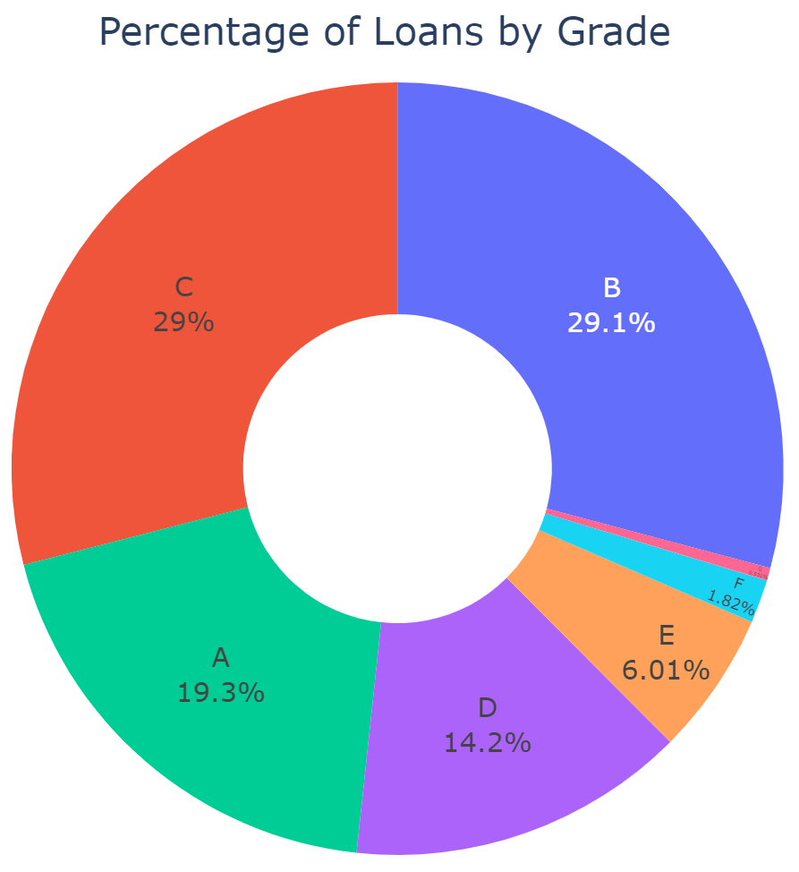
Loan Criterion: Grade

Slide 18

Loan Criterion: Grade

Slide 19
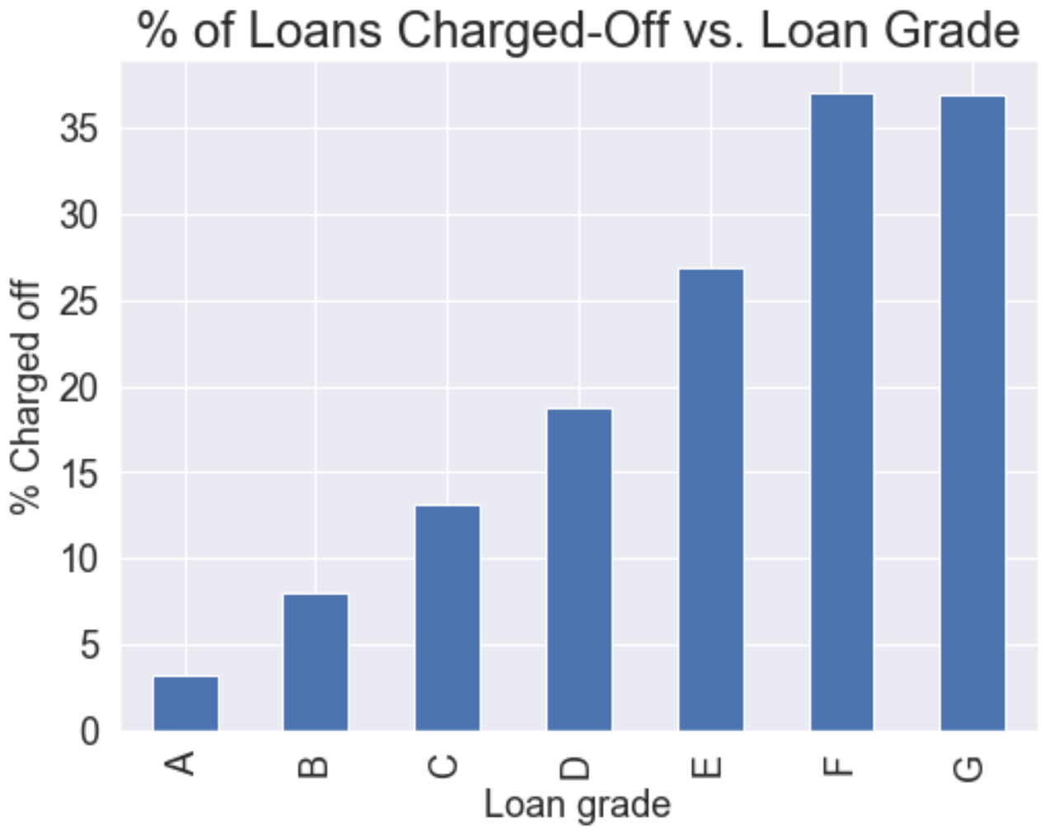
Loan Criterion: Grade

Slide 20
Loan Criterion: Grade
Key take-away: lower grade loans (such as grade G) pay a higher interest rate, but also come with a higher chance of default (loss of principal)
A risk-averse investor might want to choose a high grade loan (such as grade A) that pays a lower interest rate, but comes with a lower chance of default

Slide 21
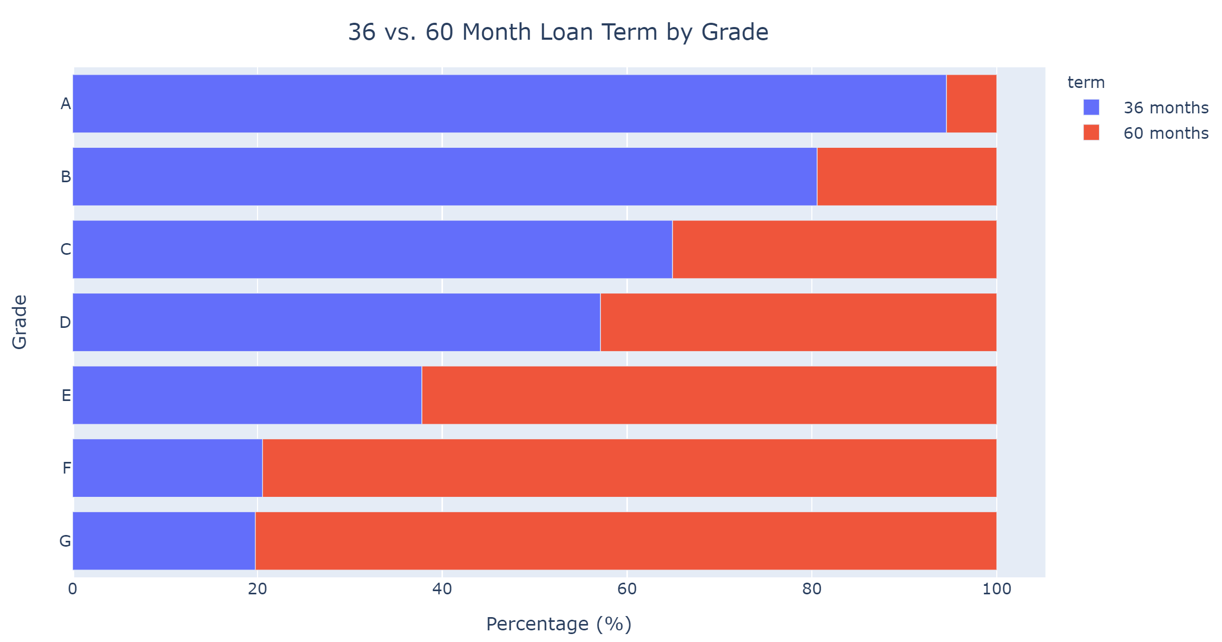
Loan Criterion: Term

Slide 22
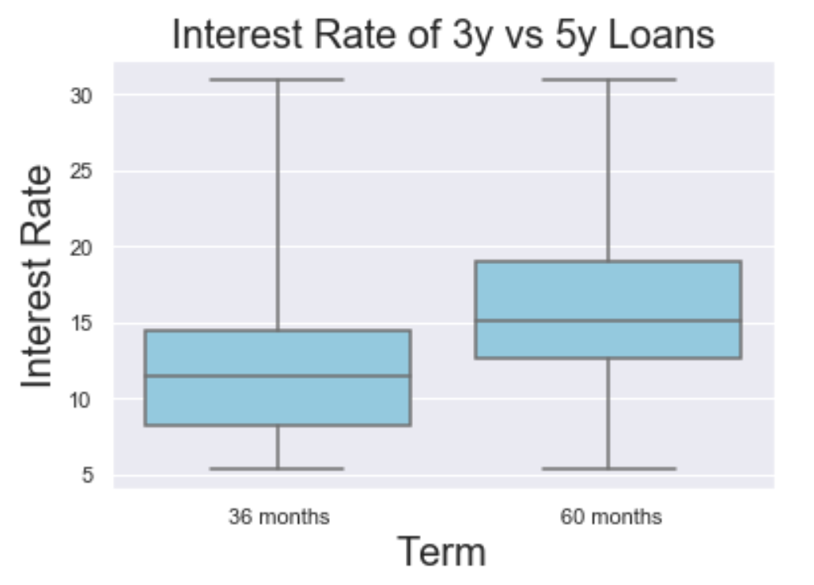
Loan Criterion: Term

Slide 23
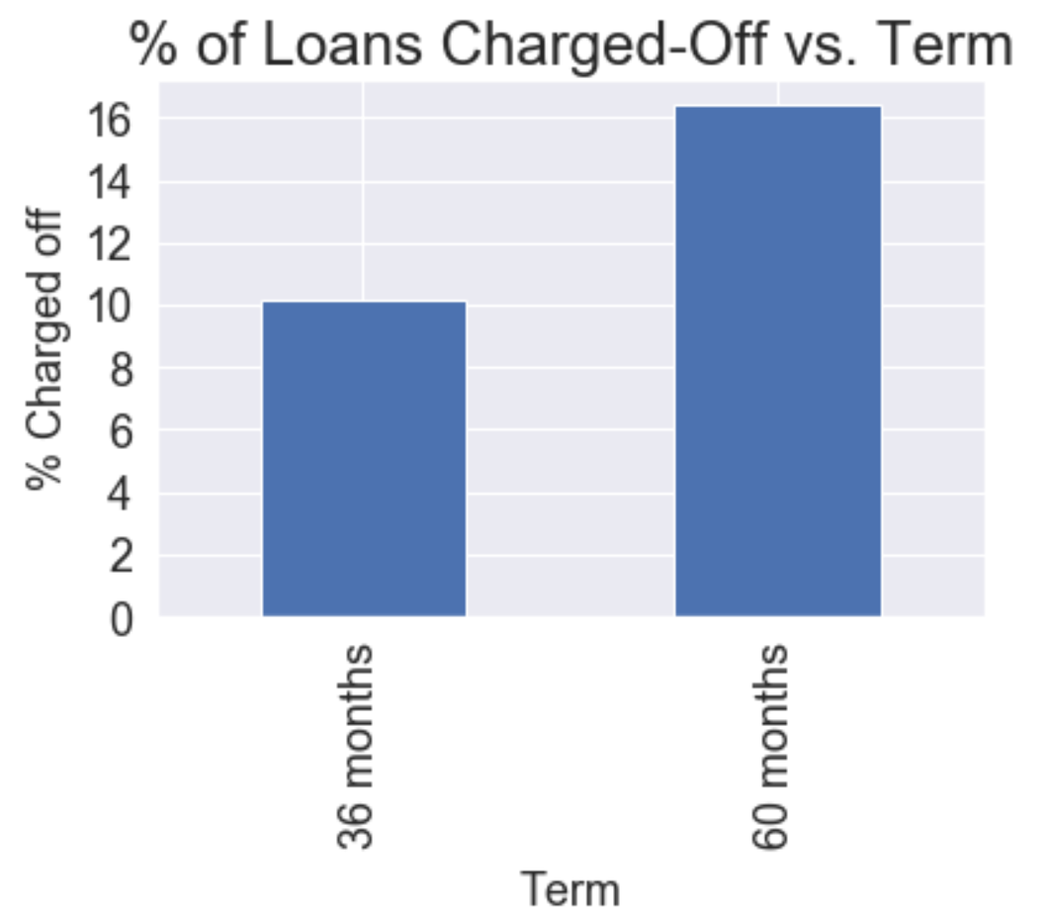
Loan Criterion: Term

Slide 24
Loan Criterion: Term
Similar take-away: 5 year (60 month) terms pay a higher interest rate, but also come with a higher chance of default (loss of principal)
A risk-averse investor might want to choose 3 year (36 month) that pays a lower interest rate, but comes with a lower chance of default

Slide 25
What About Total Return?
What we learned from term and grade: higher interest rates are associated with higher chance of default (loss of principal)
Does the higher interest rate compensate for loss of principal, on average?
Total return =
(total payments) / (funded amount of loan)

Slide 26
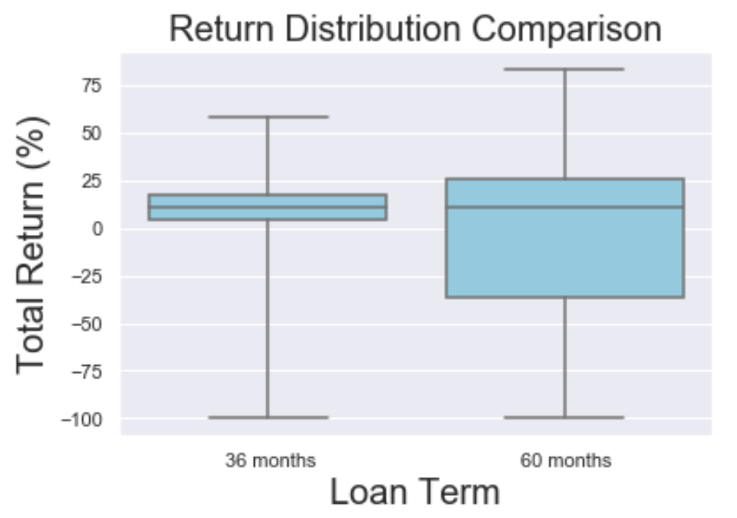
Total Return by Term

Slide 27
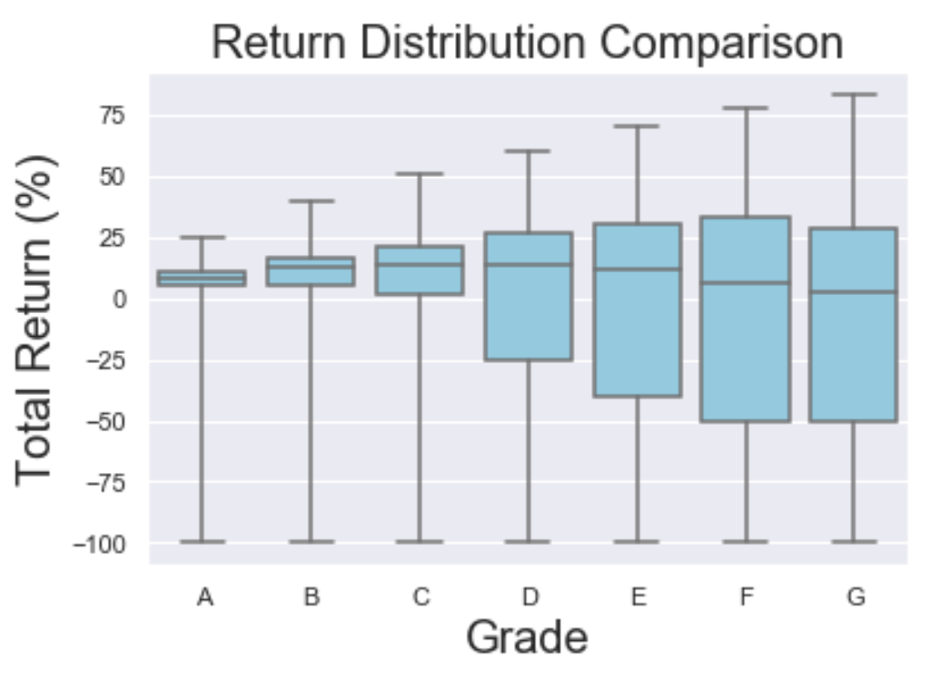
Total Return by Grade

Slide 28
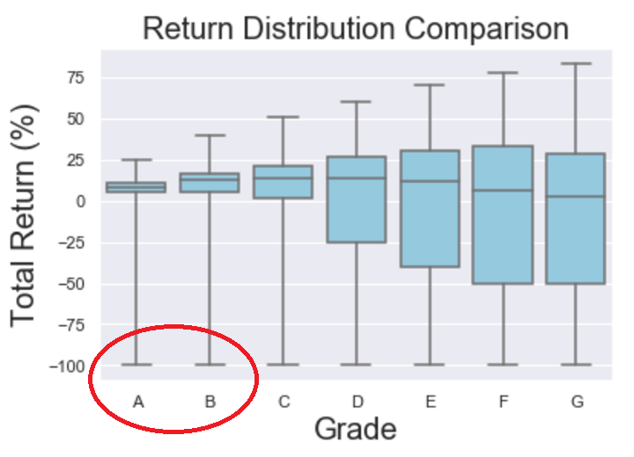
Total Return by Grade

Slide 29

How to Avoid Huge Losses?
Even grade A and B tranches contain some loans with -100% ROI (loss of all invested principal)
How can we avoid this situation?
“Don’t put all of your eggs in the same basket”
Toss 1 coin: 50% chance of tails
Toss 10 coins: 0.1% chance of all tails

Slide 30
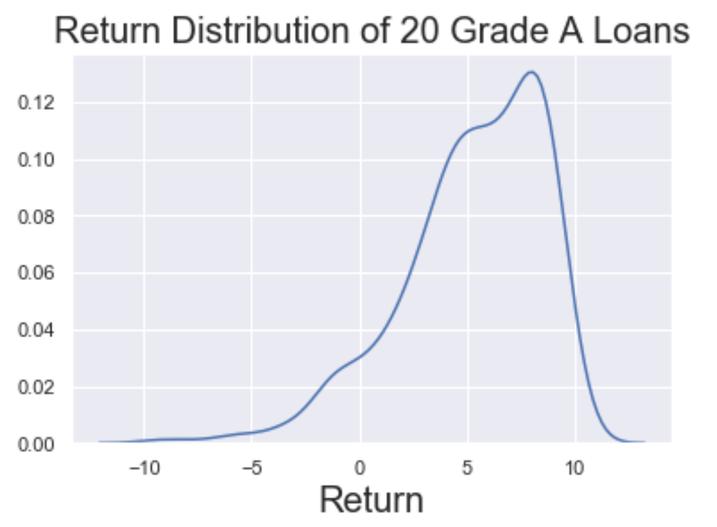
Power of Diversification
Worst return out of 1,000 simulations of a portfolio containing 20 grade A loans:
-9%

Slide 31
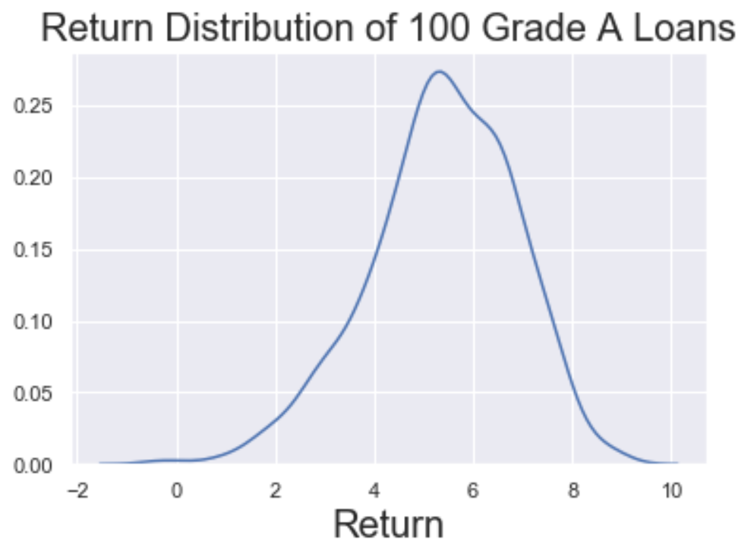
Power of Diversification
Worst return out of 1,000 simulations of a portfolio containing 100 grade A loans:
0%

Slide 32
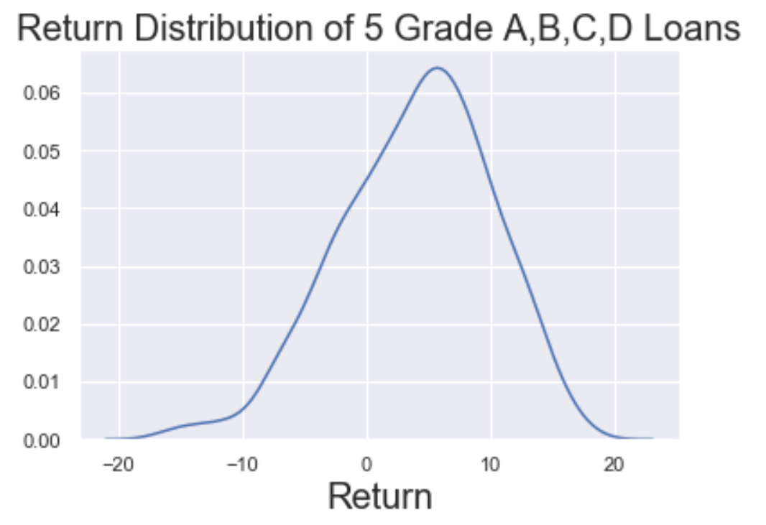
Power of Diversification
Worst return out of 1,000 simulations of a portfolio containing 5 of each grade A, B, C, D loans (20 loans total):
-16%

Slide 33
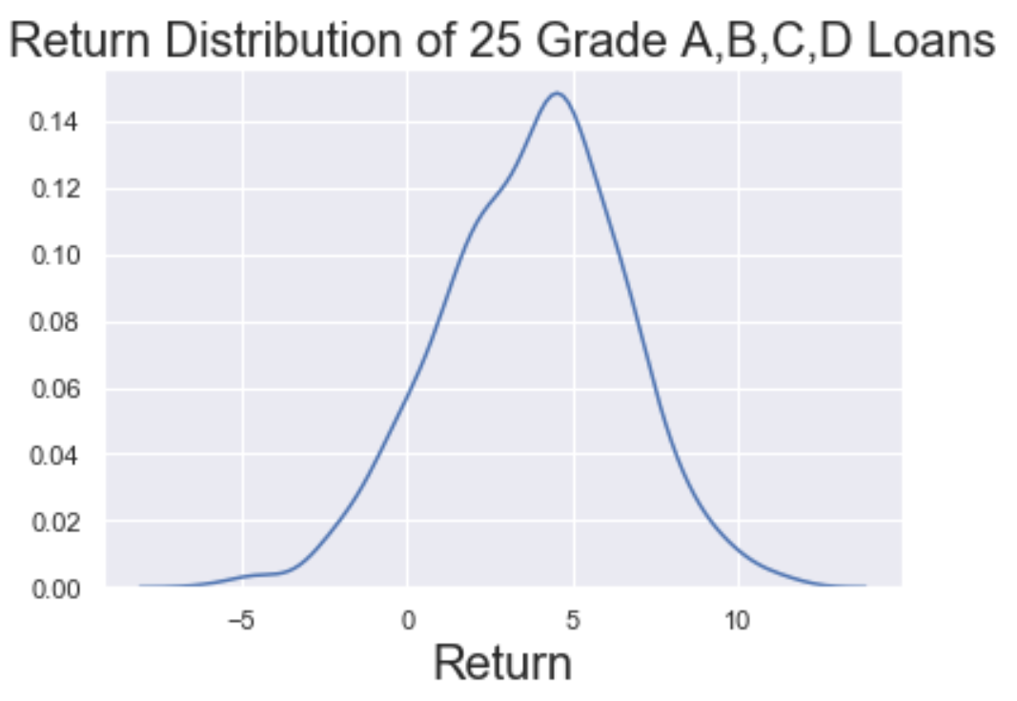
Power of Diversification
Worst return out of 1,000 simulations of a portfolio containing 25 of each grade A, B, C, D loans (100 loans total):
-5%

Slide 34
About the Authors
If you would like to learn more about the authors, please check out our Linkedin pages
Jamie Anderson: linkedin
Jon Harris: linkedin
Vincent Ji: linkedin
Joe Lu: linkedin

Slide 35
Modeling Slides

Slide 36
ML Classification Problem
Goal is risk aversion
Want to avoid ‘bad’ loans
ROI < -20%
Need ability to classify loans
Good loan: ROI > 20%
Bad loan: ROI < -20%

Slide 38
Classification Task
Purpose of ML
XGBoost Classifier Adjustments
Mean ROI of loans ~3%
However, some loans lose as much as
scale_pos_weight parameter
N (neg. obv.) / N (pos. obv.)
Could be tuned, but was not out of time constraint
AUC Precision-Recall (auc_PR) used to evaluate models
Accuracy (ROC AUC) inappropriate for imbalanced data
Ex: Guess all loans are ‘good’; already 84% accuracy

Slide 39
Modeling Notes
Imbalanced Dataset
XGBoost Classifier Adjustments
‘Good’ loans (ROI > -20%)
Classified as 1
84% of all loans
‘Bad’ loans (ROI < -20% )
Classified as 0
Only 16% of data
Goal of classifier is to avoid false positives (ie. misclassifying bad loans as good)
False negatives less harmful
scale_pos_weight parameter
N (neg. obv.) / N (pos. obv.)
Could be tuned, but was not out of time constraint
AUC Precision-Recall (auc_PR) used to evaluate models
Accuracy (ROC AUC) inappropriate for imbalanced data
Ex: Guess all loans are ‘good’; already 84% accuracy

Slide 40
Tree-Based Model **Jamie Background Info**
XGBoost – iterative approach inherent to gradient boosting
Trains models in succession to correct the residual errors made by the previous model
Random Forest algorithm was avoided due to time constraints
Not trained in succession

Slide 41
Modeling Notes
Imbalanced Dataset
XGBoost Classifier Adjustments
‘Good’ loans (ROI > -20%)
Classified as 1
84% of all loans
‘Bad’ loans (ROI < -20% )
Classified as 0
Only 16% of data
Goal of classifier is to avoid false positives (ie. misclassifying bad loans as good)
False negatives less harmful
scale_pos_weight parameter
N (neg. obv.) / N (pos. obv.)
Could be tuned, but was not out of time constraint
AUC Precision-Recall (auc_PR) used to evaluate models
Accuracy (ROC AUC) inappropriate for imbalanced data
Ex: Guess all loans are ‘good’; already 84% accuracy

Slide 42
Modeling Notes
Tuning Parameters
Results
n_estimators
max_depth
Maximum depth of a tree
Subsample
Fraction of observations to be randomly samples for each tree
colsample_bytree
Fraction of columns to be randomly samples for each tree
Logistic Regression:
Precision = 90.7%
False Discovery Rate =
XGBoost Classification:
Prediction =

